Slide 1
Tableau Desktop – Example Visualizations
Andy Salwey
As the original dashboards contain confidential information they have been edited –
either directly in Tableau to hide their context or portions of the images are blurred.
Unless specifically stated, all dashboards were created from scratch, including prepping
of appropriate datasources.

Slide 2
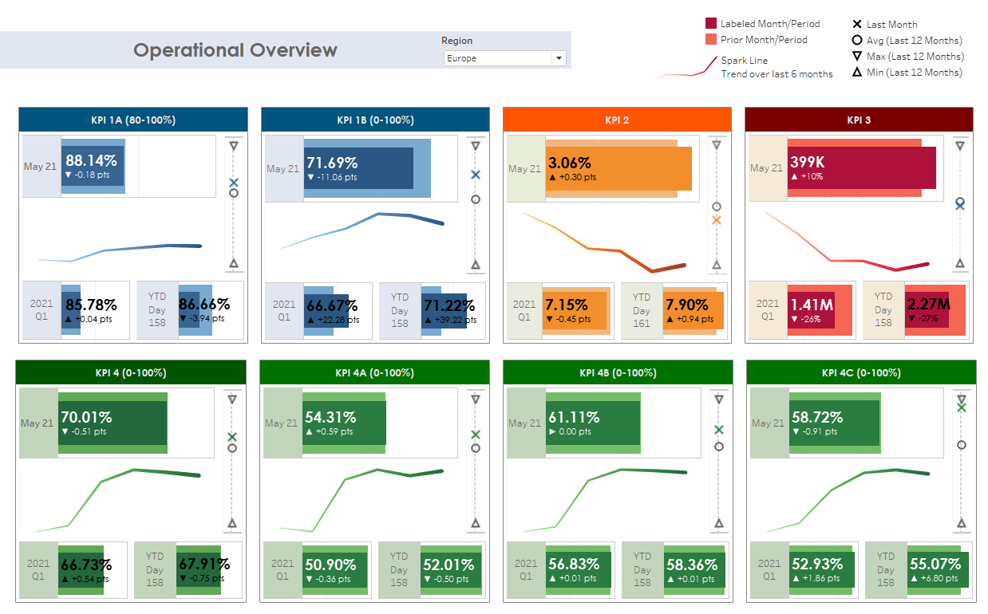
This executive dashboard was created following the request from the European CS Director to have a monthly overview with vision on the main KPIs over monthly, quarterly and year to date periods.
BANs (Big Aggregate Numbers) shown directly on charts for clarity and context with comparison to the prior period
Additional context is provided at the monthly level with a 6 month spark line and a 12 month meter chart
Colours used to create logical grouping of the KPIs

Slide 3
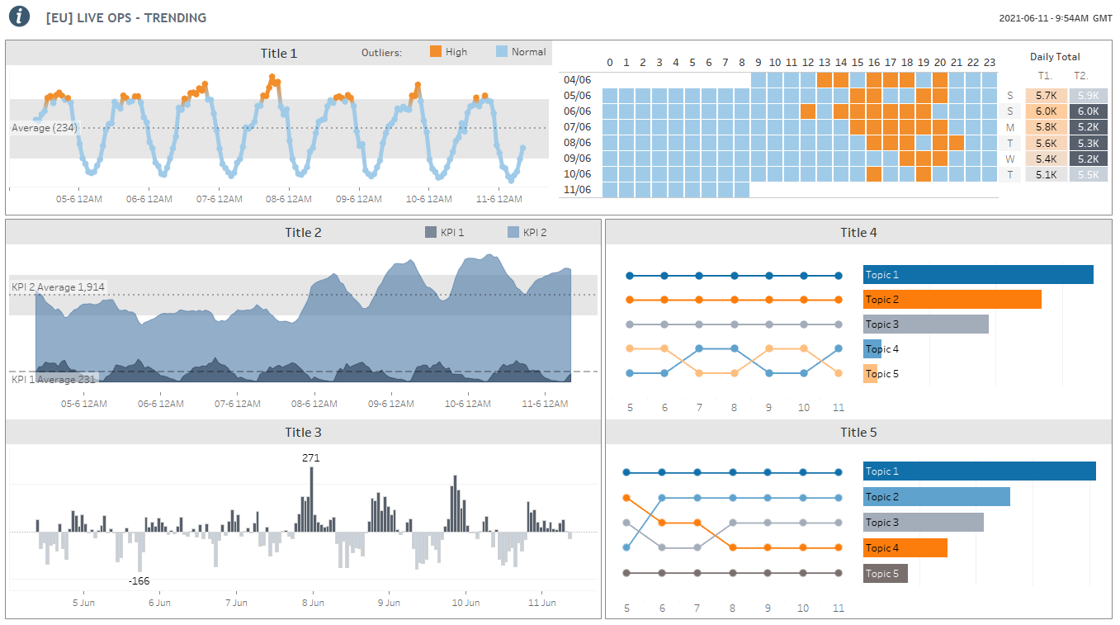
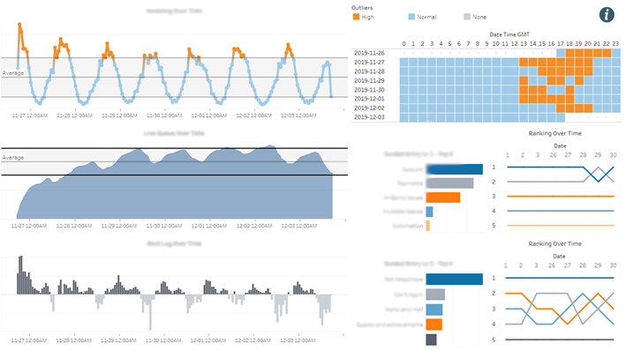
This example is one section of an operational dashboard that I took ownership over when I transitioned into the data analyst position in customer service.
As it already contained some good visualizations, these were only tweaked to add extra info while being mindful not to add clutter. Then bringing the overall look together with bolder visuals on the titles and using borders to create a logical grouping.
Initial layout

Slide 4
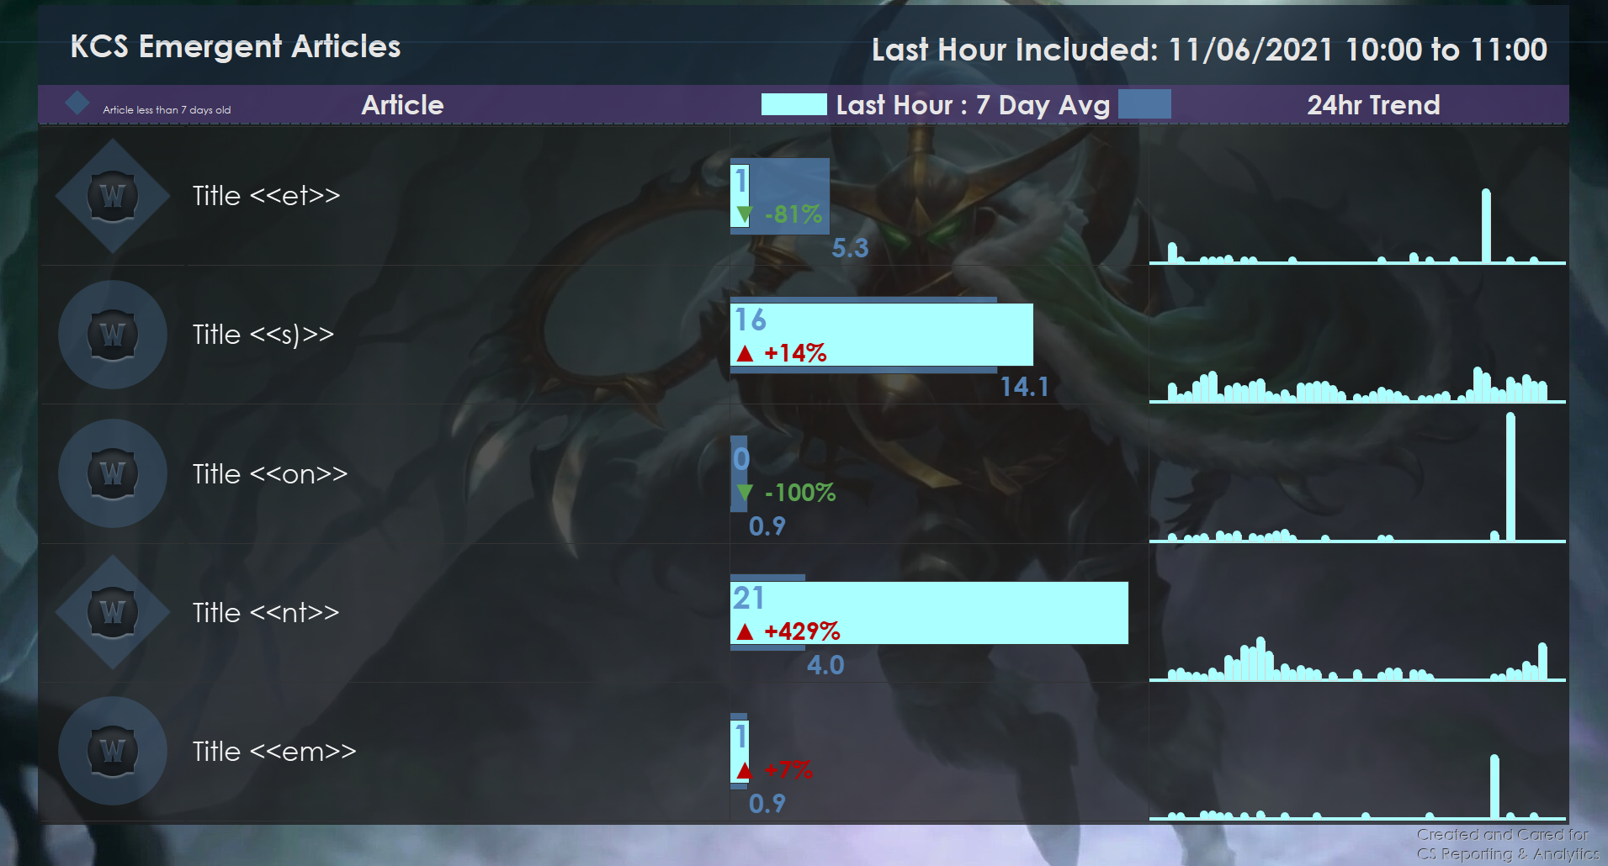
Dashboard developed for large TV screens displayed through-out the office.
More playful visuals with background image and icons
Fills entire screen with a darker image avoiding glaring screens
Sizing and colours selected for clarity so it can be read from a distance

Slide 5
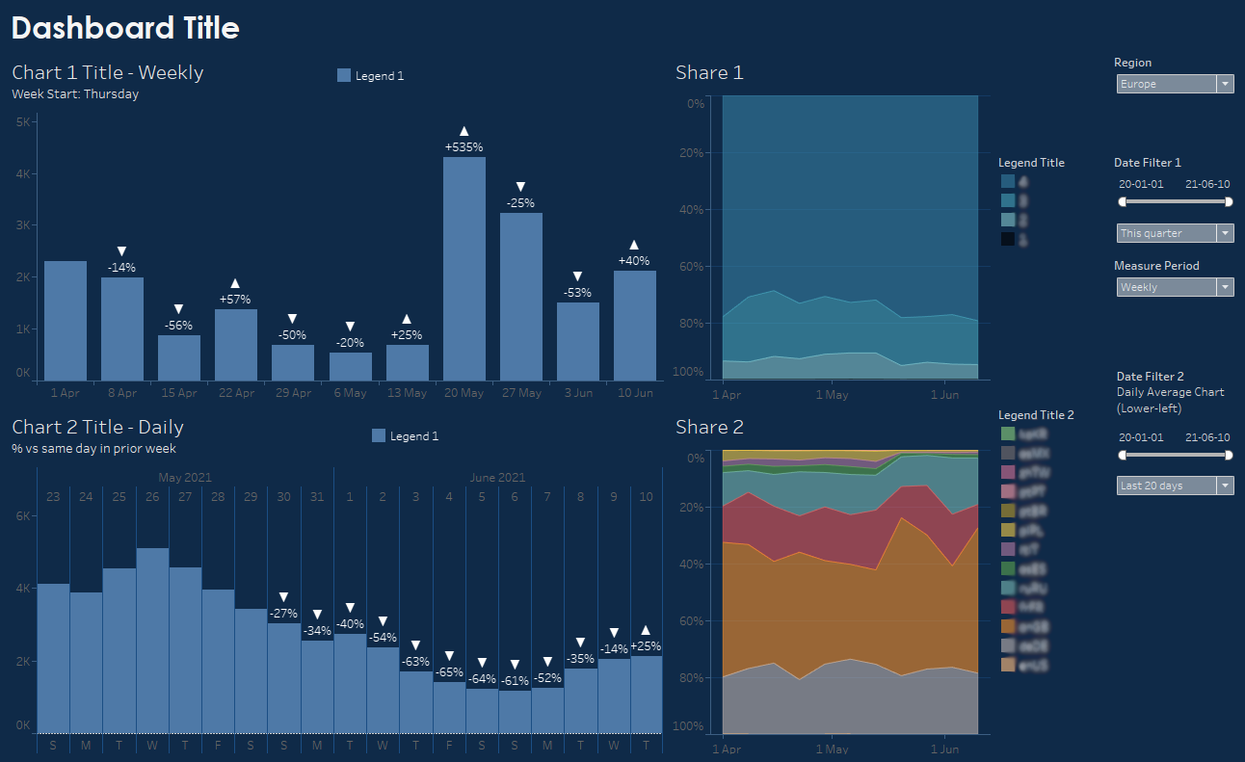
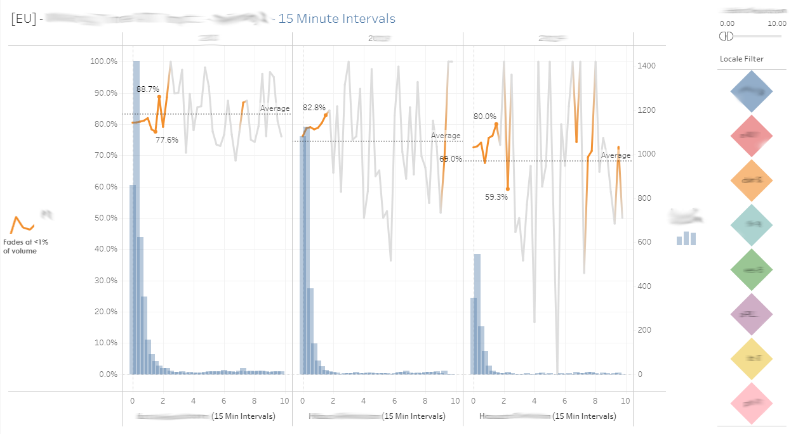
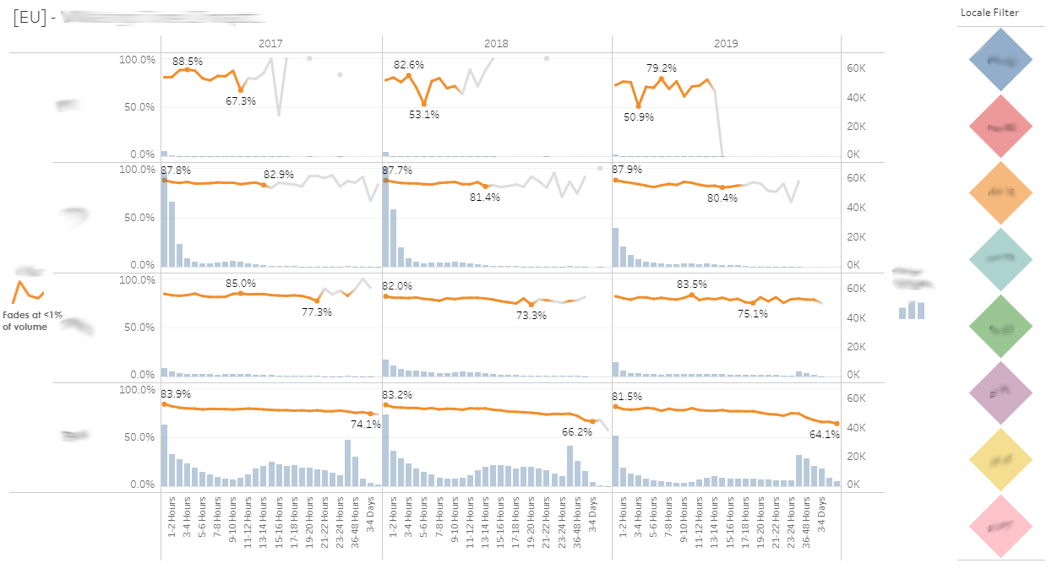
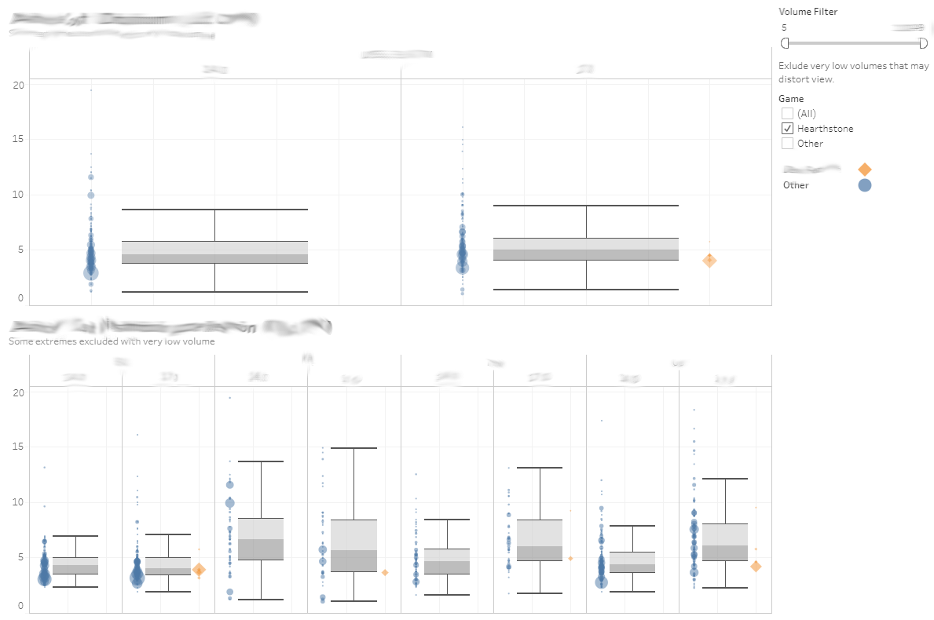
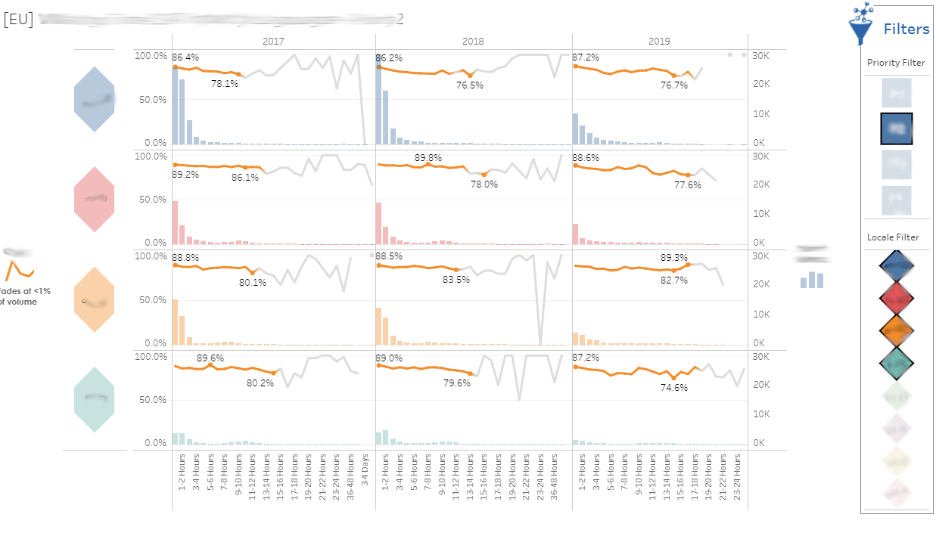

Slide 6
